Slide 1


SMART INDIA HACKATHON 2024
TITLE PAGE
Problem Statement ID –1652
Problem Statement Title-Extraction and Verification of Information from semi-categorized data.
Theme-Smart Automation
PS Category- Software
Team ID- 238
Team Name (Registered on portal)-CMD

Slide 2
IDEA TITLE
CMD
IDEA
The RAC(Recruitment and Assessment Centre) under DRDO, Ministry of Defence manually verifies applicant documents in various formats and languages, making the process slow and error-prone.
An automated IDP system (Intelligent Document Processing) using OCR (Optical Character Recognition),NLP, and Machine Learning to streamline document verification, reduce manual effort, and provide real-time feedback.
ADDRESSES THE PROBELM
Automation: Reduces manual effort and processing time.
Accuracy and Speed: Processes documents in under 3 seconds with high accuracy.
Multilingual Support: Handles various languages and formats.
Scalability: Adapts to growing volumes and evolving fraud detection.
Real-Time Judgement: Allows quick judgement after submission.
Innovation and Uniqueness
Advanced Tech Stack: Combines OCR, ML, and DL ,NLP for precise verification.
Real-Time Verification: Provides instant judgement to reduce official workload.
Multilingual and Multi-format: Handles diverse languages(marathi, tamil, etc) and document types (image/pdf).
Adaptive Learning: ML models enhance fraud detection.
User-Centric Design: Features modern UI and detailed analytics.
Future-Ready: Modular design for easy updates and enhancements.
SOLUTION
The proposed solution is a web-based Document Extraction and Verification System. It uses OCR,NLP, Machine Learning (ML), and Deep Learning (DL) to automate and streamline document processing.
Frontend (Web Page): User-friendly interface for document uploads, real-time feedback.
IDP: Extracts text, supports multilingual documents, and identifies key entities.
Verification and Reporting: Compares data with biodata, generates reports, and visualizes results with BI tools.

Slide 3
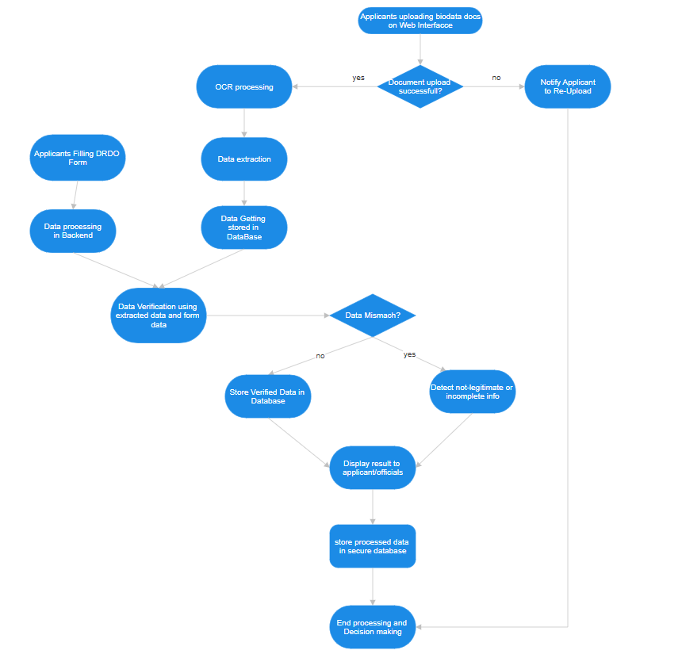
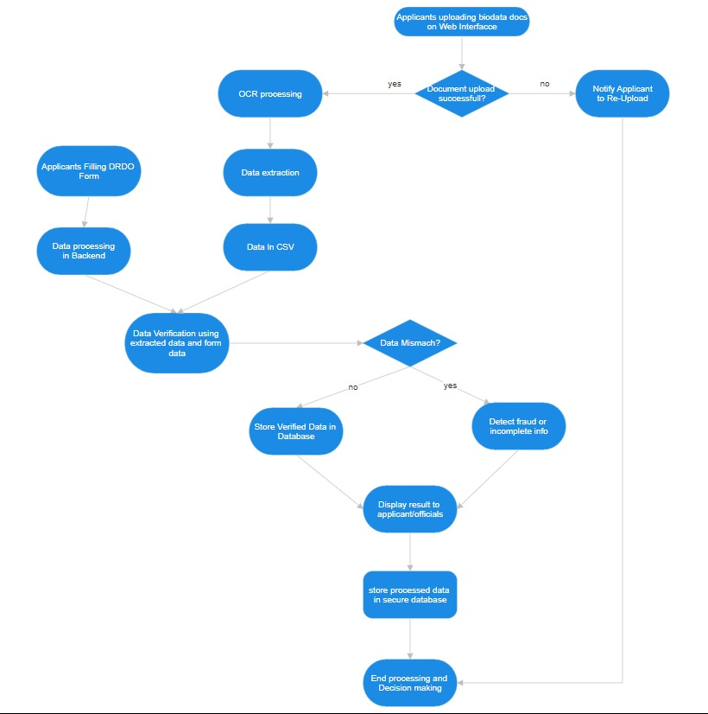
TECHNICAL APPROACH
CMD
Python: Implementing Machine Learning (ML) and Deep Learning (DL) models.
HTML/CSS/JS: For structuring and styling the web pages.
NLP: For processing and analyzing natural language data within the extracted text.
Tesseract /Easy OCR: For Optical Character Recognition (OCR) to extract text from documents.
Yolo:A real-time object detection algorithm that predicts object classes and bounding boxes in one pass.
Django:A high-level Python web framework for rapid, secure web development.
Google Colab: For developing and testing ML models.
Bootstrap/Material-UI: For pre-built UI components and styling.
MySQL:For storing applicant data, extracted text, and verification results.

Slide 4
FEASIBILITY AND VIABILITY
CMD
Feasibility Analysis
Technical: Feasible with mature OCR and ML technologies.
Operational: Practical with a web-based solution and integration with BI tools.
Economic: Manageable costs for cloud services and development.
Potential Challenges and Risks
Accuracy: Inconsistent OCR and ML results.
Multilingual Support: Limited language model performance.
Scalability: Performance issues with high document volumes.
Data Security: Risk of breaches and privacy issues.
User Experience: Potential usability problems.
Strategies for Overcoming Challenges
Accuracy: Test and update models; use fallback mechanisms. Using Confidence Score as a parameter too.
Multilingual Support: Use multilingual models(OCR); collaborate with language experts.
Scalability: Use cloud auto-scaling; optimize performance.
Data Security: Apply encryption and access controls; regular security audits.
User Experience: Conduct user testing; ensure responsive design.

Slide 5
IMPACT AND BENEFITS
CMD
Potential Impact on the Target Audience
Efficiency: Streamlines document verification, reducing processing time and manual effort.
Time Savings: Automated verification frees up recruitment officers from manual checks, allowing them to focus on more strategic tasks.
Multi-Language Support: The ability to process documents in multiple languages ensures that non-Hindi or non-English speaking applicants are not disadvantaged, promoting inclusivity.
Accessibility: Provides real-time feedback and improves the applicant experience.
Benefits of the Solution
Social: Enhances transparency and fairness in the recruitment process.
Economic: Reduces administrative costs and resource allocation for manual verification.
Credibility: Increases accuracy in verifying applicant documents, reducing errors and fraud.
Environmental: Decreases paper usage and manual handling, contributing to greener practices.
Anti-Corruption: reducing the chances of corrupt verification process.
Anti-spoofing: To prevent applicants from filling or uploading fake biodata.

Slide 6
RESEARCH AND REFERENCES
CMD
https://www.kaggle.com/datasets/mehaksingal/personal-identification-image-dataset-for-india/data
https://www.kaggle.com/code/ssakthisaravanan/adhaar-pan-ocr-extraction
Sthembile Mthethwa and Nelisiwe Dlamini, “Verifying the integrity of hardcopy document using OCR”, 2nd International Women in Science Without Borders (WiSWB)-Indaba, Johannesburg, South Africa.
Yuvaraj Singh S, "Custom Object Detection Using YOLO Integrated with a Segment Anything Model" International Research Journal of Engineering and Technology (IRJET).
https://universe.roboflow.com/jizo/aadhar-card-entity-detection

Slide 7
IMPORTANT INSTRUCTIONS
Please ensure below pointers are met while submitting the Idea PPT:
Kindly keep the maximum slides limit up to six (6). ( Including the title slide)
Try to avoid paragraphs and post your idea in points /diagrams / Infographics /pictures
Keep your explanation precise and easy to understand
Idea should be unique and novel.
You can only use provided template for making the PPT without changing the idea details pointers (mentioned in previous slides).
You need to save the file in PDF and upload the same on portal. No PPT, Word Doc or any other format will be supported.
Note - You can delete this slide (Important Pointers) when you upload the details of your idea on SIH portal.

